Slide 1

Iris
Object detection/classification using neural network.
Neural network for object detection.
Camera for capturing and rendering video frames.

Slide 2

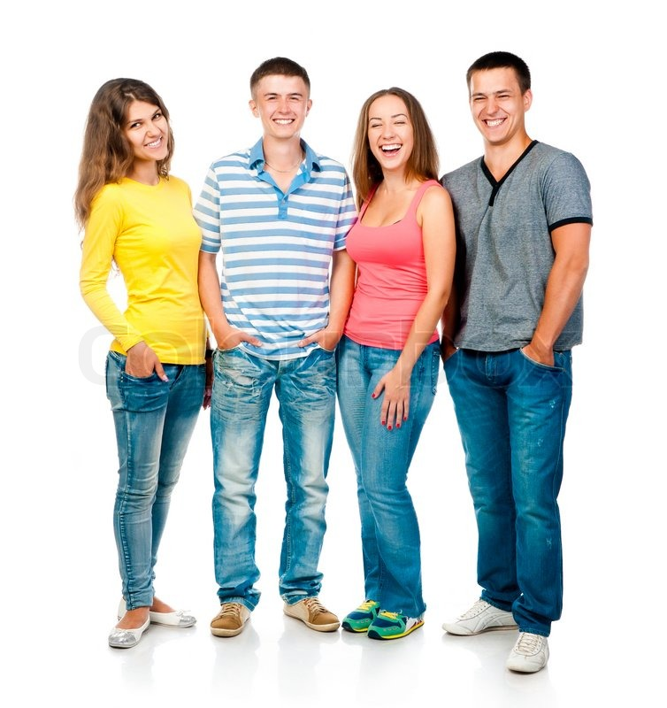
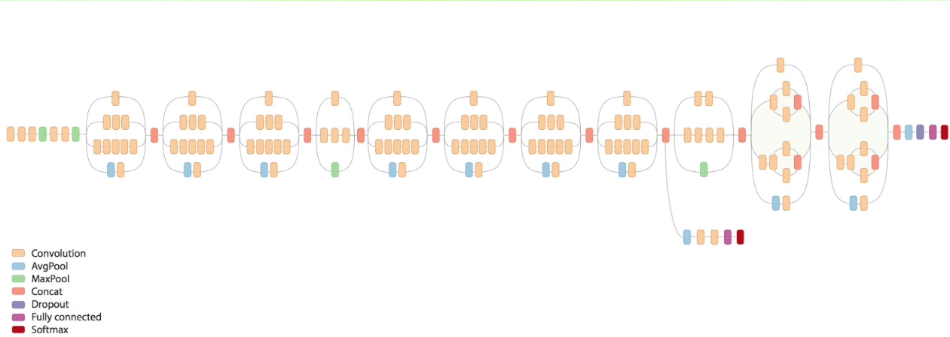
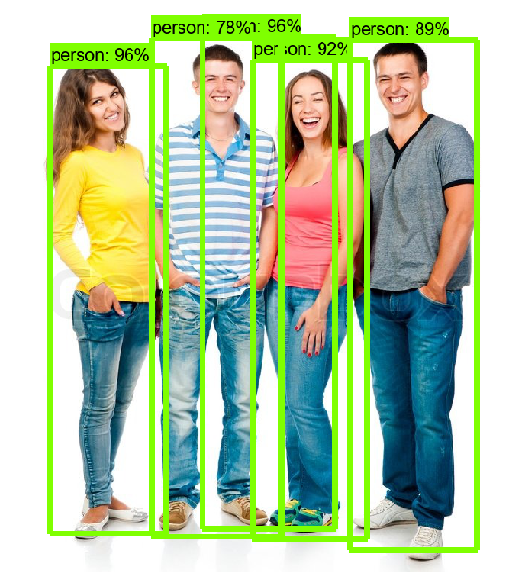
Neural Network
Building and training neural net from scratch.
Takes too long.
Out of scope of Mobile apps and more in the field of Machine learning.
Pretrained tensor flow network on coco database.
Common object in context (COCO) large-scale object detection, segmentation, and captioning dataset.
330K images (>200K labeled)
1.5 million object instances
80 object categories
91 stuff categories
Frozen neural network graph file (<file_name>.pb).
Input nodes take image as NumPy array.
Outputs nodes give detection_boxes, detection_classes, detection_scores.

Slide 3

TensorFlow's inference.
Too slow.
Will not work with normal mobile frame rate.
TensorFlow Lite
TensorFlow’s lightweight solution for mobile and embedded devices.
Enables on-device machine learning inference with low latency and a small binary size.
TensorFlow's frozen graph (<file_name>.pb) has to be converted to TensorFlow lite (<file_name.tflite>) compatible format.

Slide 4
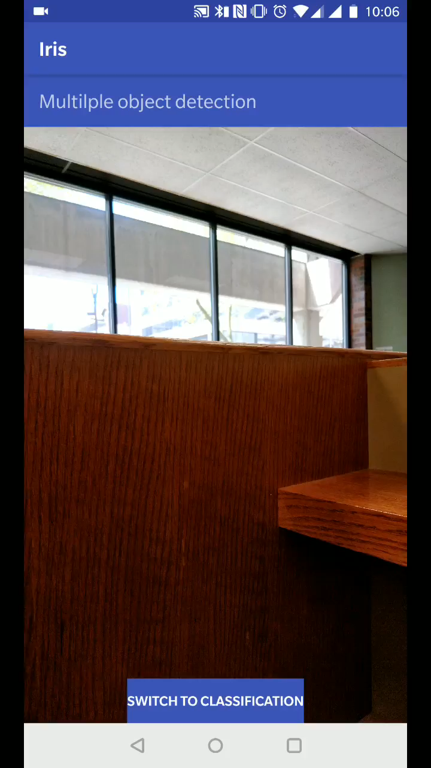
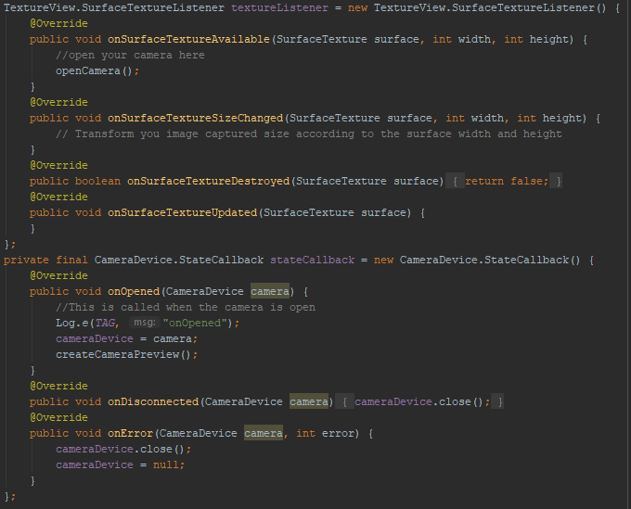
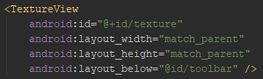
Camera 2 API (android.hardware.camera2)
The android.hardware.camera2 package provides an interface to individual camera devices connected to an Android device.
To set up incoming video stream
TextureView xml object
TextureView.SurfaceTextureListener
CameraDevice.StateCallback
Background thread to handle preview update

Slide 5
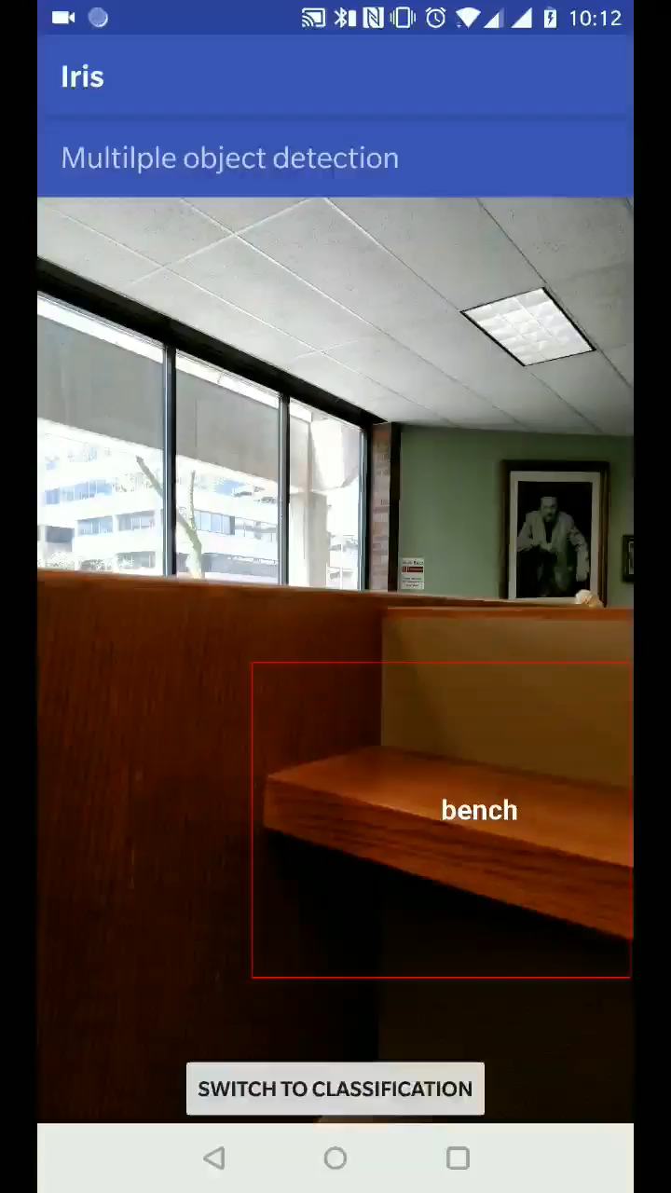
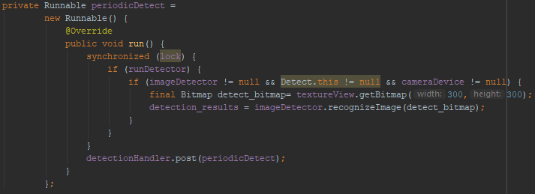
Running Inference on incoming fames
Inference steps
Read frame from TextureView
Resize frame to be compatible with neural net input nodes (300*300)
Run each frame through inference model
Process output and draw
Causes lag in video display when run on main thread
Created separate thread to run inference.

Slide 6
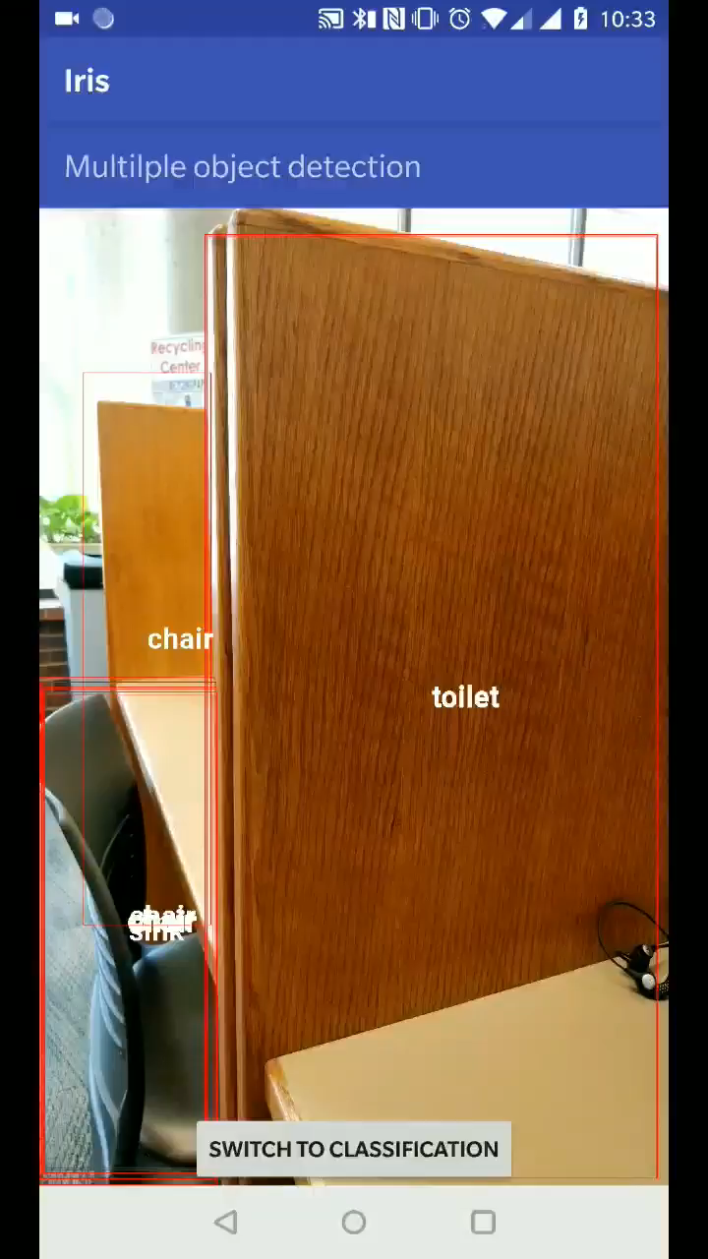
Cleaning and drawing output
Raw output from neural network is messy.
Multiple predictions of different scores for same objects.
Prediction confidence scores of varying value.
Multiple prediction problem
Save center and radius of first instance of object encountered.
Check center of every other encounter to make sure it outside the circle.
Prediction score problem
Only use objects with prediction score higher than a threshold.
Drawing rectangles
Create Canvas object using incoming Bitmap incoming frame.
Draw scaled rectangle on incoming frame.

Slide 7
Additional classification feature.
Problem with detection
Neural net output label file too small
10-20 objects can be detected without further training neural net
Individual object classification
Uses separate neural net with 1000 labels
1000 objects can be detected without further training neural net
Point camera at individual object to get prediction result

